Slide 1
A Biblical Study of
The Catechism
of the Catholic Church:
Bible Answers to the Most Frequently Asked Questions
about Catholic Beliefs and Practices
Dr. Jonathan Carl
Downloadable resources and
helpful study videos freely available at:
www.TrustworthyWord.com/catholic

Slide 2
WHY IS THE CATHOLIC BIBLE DIFFERENT THAN OTHERS?
IS THE DEUTEROCANON/APOCRYPHA TRUSTWORTHY?

Slide 3
“Tobit, Judith…1 and 2 Maccabees…Wisdom, Sirach (Ecclesiasticus)…Baruch”
(CCC 120)
+ Esther & Daniel Additions

Slide 4
READ THE APOCRYPHA FOR YOURSELF HERE: www.biblestudytools.com/rhe/
Problematic passages of The Deuterocanon to Consider:

Slide 5
Tobit 6:5-7 "And the angel, answering, said to him: If thou put a little piece of its heart upon coals, the smoke thereof driveth away all kind of devils, either from man or from woman, so that they come no more to them.”

Slide 6
This practice of burning the fish’s guts to drive the demonic away is identical to witchcraft. Is there any biblical justification for it?
Deuteronomy 18:9–14 "There shall not be found among you anyone who burns his son or his daughter as an offering, anyone who practices divination or tells fortunes or interprets omens, or a sorcerer [11] or a charmer or a medium or a necromancer or one who inquires of the dead,

Slide 7
Tobit 4:11 "For alms deliver from all sin, and from death, and will not suffer the soul to go into darkness."
Tobit 12:9 "For alms delivereth from death, and the same is that which purgeth away sins, and maketh to find mercy and life everlasting.”

Slide 8
Sirach 3:3, 30 “Whoso honoureth his father maketh an atonement for his sins...Water will quench a flaming fire; and alms maketh an atonement for sin”

Slide 9
Does giving make an “atonement for sin” or “purgeth away sins”? Isn’t that contrary to 1 John 1:7 and Hebrews 9:14 & 22?

Slide 10
Tobit 3:24 “Raphael, one of the Lord’s holy angels, was sent out, bearing common deliverance to the suppliants of a single hour”

Slide 11
Why does the name Raphael appear for angels in Islam, Mormonism, the Babylonian Talmud, and the book of 1 Enoch?

Slide 12
Tobit 12:16-22 “the fell down trembling, face to earth. Peace be with you, the angel said…for three hours together, face to earth, they gave thanks to God”
When Tobias and his father fall down before the angel Raphael, why does the angel not stop them from bowing down (for three hours)?

Slide 13
Sirach 12:4-7 advices, “Give to the godly man, and help not a sinner. Do well unto him that is lowly, but give not to the ungodly; hold back thy bread, and give it not unto him... give unto the good, and help not the sinner.”
Tobit 4:17 “Bestow thy meat and thy drink upon a just man’s burying, never share them with sinners.”

Slide 14
Wisdom 8:19,20 “For I was a witty child, and had a good spirit. Yea rather, being good, I came into a body undefiled.”

Slide 15
2 Maccabbees 12:43 "And making a gathering, he sent twelve thousand drachms of silver to Jerusalem for sacrifice to be offered for the sins of the dead, thinking well and religiously concerning the resurrection.”

Slide 16
2 Maccabbees 12:44-46 “For if he had not hoped that the that were slain should rise again, it would have seemed superfluous and vain to pray for the dead, 45 And because he considered that the who had fallen asleep with godliness, had great grace laid up for them. 46 It is therefore a holy and wholesome thought to pray for the dead, that they may be loosed from sins.”

Slide 17
Judith 1:5 "Now in the twelfth year of his reign, Nabuchodonosor, king of the Assyrians, who reigned in Ninive the great city, fought against Arphaxad and overcame him.”
Why does Judith claim Nebuchadnezzar to be the king of the Assyrians when he was the king of the Babylonians?

Slide 18
Baruch 6:2, "And when you are come into Babylon, you shall be there many years, and for a long time, even to seven generations: and after that I will bring you away from thence with peace.”
Jeremiah 25:11 says the Jews would serve in Babylon for 70 years while Baruch says seven generations. Why the difference?

Slide 19
Sirach (Ben Sira) 40:29-30 “My son, in thy lifetime be not indigent: for it is better to die than to want. 30 The life of him that looketh toward another man's table is not to be counted a life: for he feedeth his soul with another man's meat.”

Slide 20
[You should divorce if your wife does not obey you] Sirach 25:35-36 “If she walk not at thy hand, she will confound thee in the sight of thy enemies. 36 Cut her off from thy flesh, lest she always abuse thee.”

Slide 21
Jeremiah took the tabernacle of the ark to a cave in the mountain Moses saw Canaan. 2 Maccabees 2:1-16

Slide 22
Four Reasons the Apocrypha/Deuterocanon Should Not Be In the Bible
From: www.biblicaltraining.org/library/canon-scripture-wayne-grudem
1) they do not claim for themselves the same kind of authority as the Old Testament writings;

Slide 23
2) they were not regarded as God’s words by the Jewish people from whom they originated;
3) they were not considered to be Scripture by Jesus or the New Testament authors

Slide 24
4) they contain teachings inconsistent with the rest of the Bible.

Slide 25
A Brief History of the Canon of the Bible

Slide 26
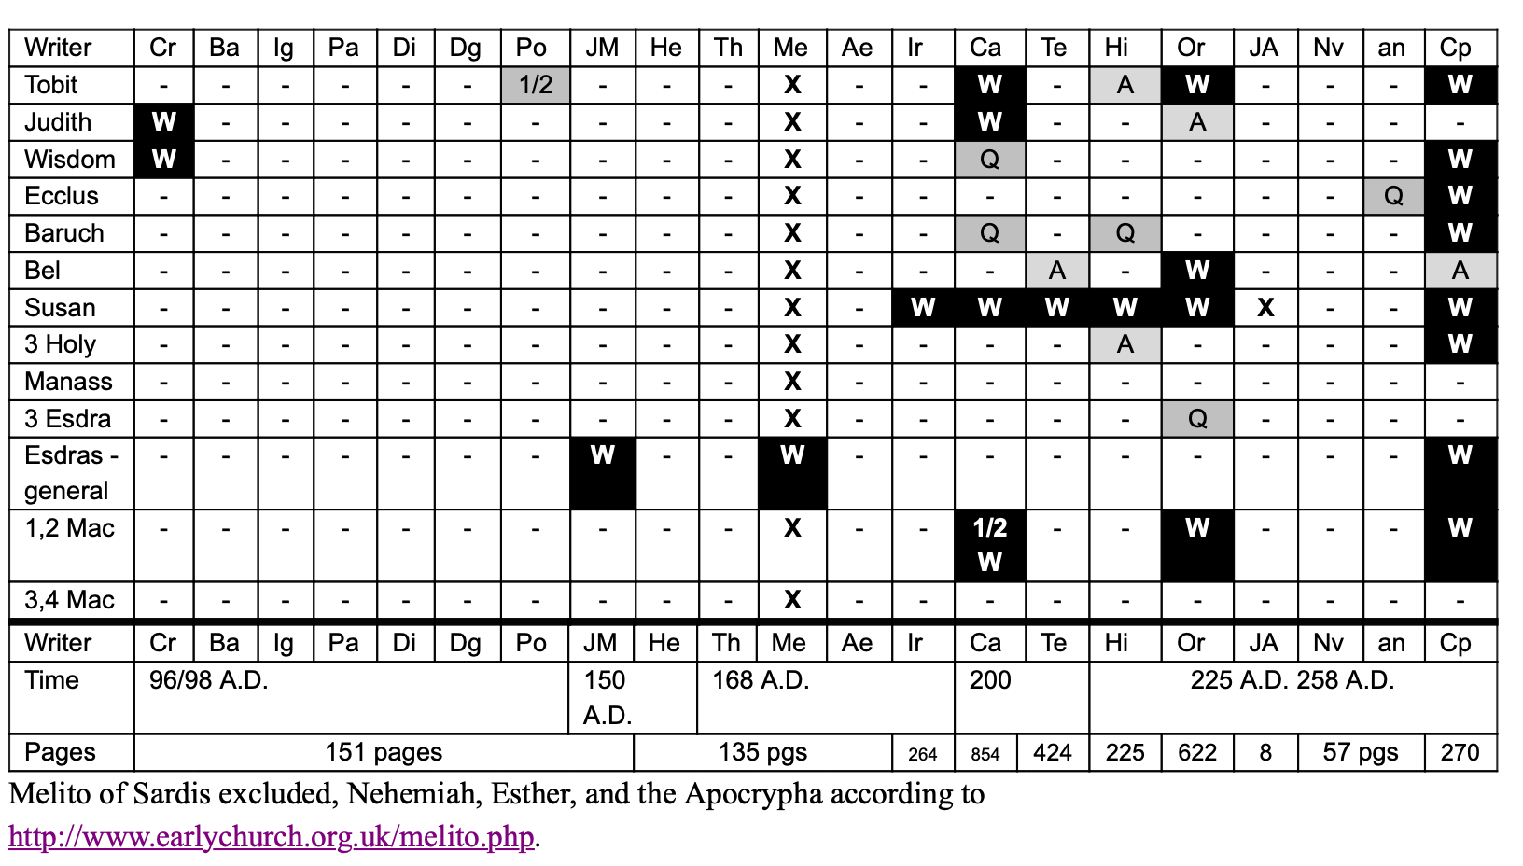
Cr 1 Clement (of Rome) (16 pgs) 96/98 A.D.
Ba Epistle of Barnabas (13 pgs) c.100 A.D.
Ig Ignatius (21 pgs) c.110-117 A.D.
Pa Papias disciple of John (3 pgs) 110-113 A.D.
Di Didache (Teach. of 12 Disc.)(6 pgs) before 125 A.D.
Dg (anonymous) to Diognetus (6 pgs) c.130 A.D.
Po Polycarp, disciple of John (4 pgs) c.150 A.D.
Jm Justin Martyr (119 pgs) c.138-165 A.D.
He Shepherd of Hermas (47 pgs) 160 A.D.
Th Theophilus [Antioch] (33 pgs) 168-181/188 A.D.
Me Melito of Sardis (11 pgs) 170-177 A.D.
Ae Athenagoras (34 pgs) c.177 A.D.
Ir Irenaeus (264 pgs) 182-188 A.D.
Ca Clement of Alexan. (424 pgs) 193-217/220 A.D.
Te Tertullian [Rome] (854 pgs) 200-220 A.D.
Hi Hippolytus, (233 pgs) 225-235/6 A.D.
Or Origen (622 pgs) 230-254 A.D.
Nv Novatian (39 pgs) 250-257 A.D.
an Anonymous against Novatian(7 pgs) c.255 A.D.
And Treatise on Rebaptism (11 pgs)
Cp Cyprian and friends (270 pgs) 248-258 A.D.
Not shown are Bardesan (154-230) [ref. to Gen] or Julius Africanus (232-245 A.D.). [Neh,Dan by name, allude Ex]
W = Books or quotes mentioned by name or by writer
G = Mentioned as words of God + quoted
B = Mentioned as scripture or quoted + "it is written"
Q = quote of 1 or more verses. 1/2 = quote of 1/2 a verse
A = Allusion. - = no reference

Slide 27
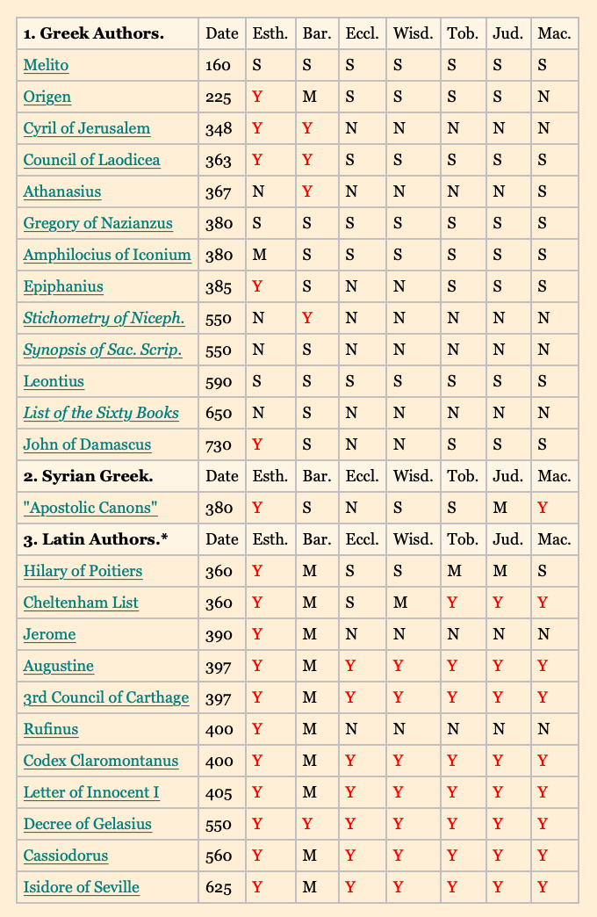
Disputed Books of the Old Testament
The table shows which of the disputed Old Testament books are included in Christian catalogs of canonical books up to the eighth century.
Y indicates that the book is plainly listed as Holy Scripture;
N indicates that it is placed in an inferior class of books;
M indicates that the terminology of the author may be construed as a reference to the book as Holy Scripture.
An S indicates that the author does not mention the book in his catalog, which implies its rejection. See notes on the authorities below.
http://www.bible-researcher.com/canon4.html
Esth. - Esther
Bar. - Baruch
Eccl. - Ecclesiasticus
Wisd. - Wisdom of Solomon
Tob. - Tobit
Jud. - Judith
Mac. - First and Second Maccabees

Slide 28
WHY IS THE CATHOLIC BIBLE DIFFERENT THAN OTHERS?
IS THE DEUTEROCANON/APOCRYPHA TRUSTWORTHY?

Slide 29
A Biblical Study of
The Catechism
of the Catholic Church:
Bible Answers to the Most Frequently Asked Questions
about Catholic Beliefs and Practices
Dr. Jonathan Carl
Downloadable resources and
helpful study videos freely available at:
www.TrustworthyWord.com/catholic

