Slide 1
Living & Parenting In A Sexualized (Confused) Culture
Spring 2022
Notes:
I titled this living AND parenting in a sexualized culture – because though the aim of our talk is towards parenting, we are always still LIVING in this sexualized culture – and we parents struggle too!

Slide 2
Introduction
Jenny S. Carl, M.D.
Family Physician (OB Fellowship)
Leighton H. Carl, M.D.
Family Physician
BaylorScott&White Hillcrest – Bosque Clinic
Miriam (15), Zeke (13), Judah (10.5), Esther (9), Ruth (7), and Solomon (2)
Notes:
We titled this “Living AND Parenting” because I think part of the challenge for all of us is to first learn how WE OURSELVES should live, before we can properly parent and teach our kids on this important subject. (Which goes for anything in life, right?)
We’re so glad each of you is here! You don’t need a medical degree or seminary degree to do this stuff. Your love for your kids qualifies you to be an expert on this important subject!

Slide 4
Today’s Objectives
Understand our current cultural state
Understand normal sexual development
Cast a vision for our children
Empower you (parents) to teach, guide, and disciple your children on this important topic.

Slide 5
www.TrustworthyWord.com/carl

Slide 6
Why is sex education so important???
Notes:
Tell our story of how we got into speaking about this topic

Slide 7
My Life Priorities
All have sinned
Sin’s penalty
Christ paid the penalty
Must receive Christ
Growing in Godliness
Proclaim Christ to others
God
Marriage
Children
Job
Communication skills
How to forgive others
Financial management
Selflessness
Sex/faithfulness
Patience
Unconditional Love
Discipleship
Leaving a Legacy
What should I teach my kids to know and succeed at these priorities?
Education
Hard Work
Perseverance
Find Your Passion
Servant Leadership
Notes:
Of all the things you need to teach your kids, SEX is probably the most intimidating topic. And thus, we tend to often avoid or neglect it!

Slide 8
Sex Discussion Timeline
3 years old: Start intentional conversations
6-7 years old: Child should know what “sex” is
8-10 years old: More comprehensive discussions
the traditional age of 11-12 (5th/6th grades) for “the talk” is too late!!!
Notes:
MOST IMPORTANT SLIDE!!!
When should we start discussing sex and sexual development with our kids???
Their worldview is being formed as early as 2 years old!!!
6-8 yo = Kindergarten to 2nd grade
Not my recommendations alone – James Dobson is another proponent of early parental sex education
8-10 yo – 2nd to 4th grade – age you start or go more in-depth may depend on your family dynamics (bigger family/older kids), discussions with other kids at church/sports
Don’t underestimate MEDIA exposure or ability to navigate the internet
NSFG Survey of 15-19 yo – only 11.7% (girls) and 17.8% (boys) reported hearing about “how to say no to sex” in grades 1-5 – rest were in grades 6-9 mostly (approx. 14-15% per after then)
https://www.cdc.gov/nchs/nsfg/key_statistics/s.htm#sexeducation

Slide 9
Why are we here???
Potential Dangers for Our Kids:
Sexually Transmitted Infections (STI’s)
Unplanned Pregnancies
Broken Hearts
Broken human relationships
Spiritual brokenness
Sexual Addiction
Sexual Abuse
Sexual Confusion
(PORNOGRAPHY)
Notes:
The consequences of sexual brokenness in our world
Shame, guilt, hurt, pain, struggles, disappointments are common to almost everyone!
Pornography is single-handedly amplifying sexuality in our culture to unprecedented levels

Slide 10
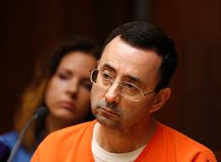
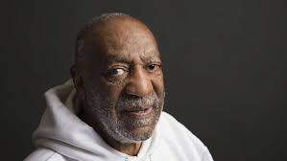
Notes:
Bill Clinton, Charlie Sheen, Larry Nassar, Prince Andrew/Jeffrey Epstein, Andrew Cuomo, Harvey Weinstein, Bill Cosby, Matt Lauer, MeToo Movement, Donald Trump, Al Franken, Morgan Freeman, Robert Kraft, Bruce (Caitlyn) Jenner, Arnold Schwarzenegger, SBC Church Expose, Bill Hybels (Willow Creek Comm. Church, Chicago), Tiger Woods, Catholic Church Clergy Abuse Conference, Michael Jackson
So why is sex education so important? Here’s a long line of people (mostly men) who have been “successful” from the world’s eyes, but have fallen publicly due to their poor decisions in the area of sex….

Slide 11
Teen/Pre-marital Sexual Activity
U.S. High School survey 2017 (YRBS - CDC), ages 15-19
40% have had sex
Non-significant difference from 2015 (41%)
Significant difference from 1991 (54%)
20% in 9th grade, 57% in 12th grade
10% had four or more sexual partners
Pre-marital Sex (NSFG – CDC)
Men (ages 20-44) – 90-91% report (steady from 2002-2015)
Women (ages 15-44) – 84% (2002) to 88% (2015)
Mean age for first intercourse for both men and women – 17 years
Notes:
What about our kids??? Are they having sex???
https://www.cdc.gov/mmwr/volumes/67/ss/ss6708a1.htm?s_cid=ss6708a1_w accessed 4/21/19
In the words of our church’s youth director – “Your kids ARE having sex”
https://www.cdc.gov/nchs/nsfg/key_statistics/p.htm#premarital
Defined as male-female vaginal sex

Slide 12
Sexually Transmitted Infections (STI’s)
2017 Statistics for U.S. (CDC)
Chlamydia – 1.7 million cases (22% increase since 2013); Texas #18 (per capita)
Gonorrhea – 555,608 cases (67% increase); Texas #22
Syphilis – 30,644 (76% increase); Texas #18
HPV (most frequent STI because it can be contracted more than once) prevalence 42% among adults age 18-59
HSV (most prevalent because it is not cleared) – ages 14-49 approximately 12.6% (self-report)
Ages 15-24 – rates of all STI’s increasing (2017)
50% of all new STI’s in US occur in age 15-24
25% of all sexually active adolescents have had an STI
Notes:
HPV data – 2013-2014, https://www.cdc.gov/std/stats17/other.htm
HSV data – NHANES survey 2010, ibid – TYPICALLY AN UNDER-REPORTED STI
So much for “safe sex”!!!

Slide 13
Unplanned Pregnancies
213 million pregnancies worldwide in 2012
40% unintended (85 million)
50% ended in abortion
13% ended in miscarriage
38% ended in unplanned birth
6.1 million pregnancies in the U.S. in 2011
45% (2.8 million) were unintended
27% “wanted later”, 18% “unwanted”
42% ended in abortion (excluding miscarriages)
58% ended in birth
210,000 babies born to girls age 15-19 in U.S. in 2016
1 teen pregnancy delivers about every 2.5 minutes
Notes:
https://www.ncbi.nlm.nih.gov/pmc/articles/PMC4727534/ (accessed 3/31/19)
https://www.guttmacher.org/fact-sheet/unintended-pregnancy-united-states (accessed 3/31/19)
https://www.cdc.gov/healthyyouth/sexualbehaviors/index.htm (accessed 4/21/19)

Slide 14
Sexual Abuse, Harassment, & Addictions
About 1 in 3 women (36%) and 1 in 6 men (17%) experience some form of sexual violence in their lifetime (NISVS Survey 2012, CDC)
Nearly 6 out of 10 sexual assaults occur in the victim’s home or the home of a friend, relative, or neighbor. (endsexualviolenceCT.org)
Nearly two-thirds of college students experience sexual harassment (AAUW Educational Foundation, 2005)
3 in 5 women, 1 in 5 men may experience sexual harassment – though 80% of people may never report it (US EEOC, eeoc.gov)
Sexual addiction prevalence is estimated at 3-6% (definition varies)
Estimated 15% of men have paid for sex (2006, KinseyInstitute.org)
Notes:
Disconnect in medical definition of sexual addiction – esp when 15% of men have paid for sex (which sounds like an addiction to me)

Slide 15
Pornography
55% of married men/70% of unmarried men watch porn monthly (2016)
Men Watch Monthly -79% age 18-30, 67% age 31-49, 49% age 50-68
Women Watch Monthly - 76% age 18-30, 16% age 31-49, 4% age 50-68
57% of teens search out porn at least monthly (ages 13-17, 2016)
Large U.S. Catholic HS Male Survey 2016
6% view porn multiple times daily
15% viewed it daily
49% viewed it more than once/week
20% viewed it once/week or less
Most common ways – smartphone (57%), tablet (24%);
in bedroom (61%), elsewhere in house (21%)
Notes:
CovenantEyes.org
HS Survey – only 10% not accounted for (not watching any porn?) – surprisingly low amount
Should we let our kids keep their smartphones in their bedrooms???
Technology is driving a lot of these increases!

Slide 16
More Porn Stats…
Positive response to the statement “I started looking at
pornography before puberty” (2016 Barna Survey)
6% of men age 51-69
13% of men age 31-50
27% of men age 25-30
42% of teens admitted clearing their browsing history after using the Internet
27% of teens receive sexts, 15% are sending them. (2018 study)
Is porn use just as bad in Christians???
64% of Christian men and 15% of Christian women view porn monthly; compared to 65%/30% non-Christian men/women. (2014 Barna)
1 in 5 youth pastors, 1 in 7 senior pastors struggle with porn (2016 Barna)
Notes:
Newer generations are getting exposed to pornography at VERY EARLY ages.
PIED – “Porn-Induced Erectile Dysfunction”

Slide 17
Broken Relationships
Marital satisfaction is highest in couples who have only
had sex with their spouse.
The more sexual partners in the past, the less satisfying your marriage.
Living with your spouse before marriage increases the risk of divorce by 50%
Having a child together before marriage increases the risk of divorce as well.
Prior to marriage, having sex with or co-habitation with someone other than your mate increases the risk of divorce.
Cohabitation is associated with economic disadvantage and family instability for children.
Children in cohabitating families have increased negative life outcomes, including depression, drug use, school drop-outs.
Children in unmarried families have increased risks of physical, sexual and emotional abuse.
Notes:
https://www.theatlantic.com/health/archive/2018/10/sexual-partners-and-marital-happiness/573493/
https://ifstudies.org/ifs-admin/resources/education/how-to-lower-your-risk-of-divorce-advice-to-singles-family-studiesfamily-studies.pdf
https://www.psychologytoday.com/us/blog/sliding-vs-deciding/201807/the-risks-couples-moving-in-together
https://ifstudies.org/blog/for-kids-parental-cohabitation-and-marriage-are-not-interchangeable
https://firstthings.org/myths-about-living-together
Less sexual baggage before your marriage improves satisfaction in your marriage!
Cohabitation increases the risk of divorce, leads to economic disadvantage and family instability once kids arrive.
Kids in cohabitating and unmarried families have many negative outcomes and an increased risk of abuse.
The first statements are only important if a persons cares about or plans on marriage – which most people still do.

Slide 18
Sexual Confusion
7.1% of US Adults self-identify as LGBTQ+ (Gallup, 2021)
86% heterosexual, 6% no opinion
Was 3.5% in 2012
Among current LGBTQ+ self-identifiers:
56.8% Bisexual
20.7% Gay
13.9% Lesbian
10% Transgender
Of Gen Z adults (born 1997-2012), 20.8% self-identify as LGBTQ+
75.7% heterosexual, 3.5% no opinion
10% of Millenials (born 1981-1996)
4.2% of Gen X (born 1965-1980)
2.6% of Boomers (born 1946-1964)
Notes:
https://news.gallup.com/poll/389792/lgbt-identification-ticks-up.aspx

Slide 19
Americans' Self-Identification as LGBT, by Generation
 | LGBT | Straight/Heterosexual | No response
 | % | % | %
Generation Z (born 1997-2003) | 20.8 | 75.7 | 3.5
Millennials (born 1981-1996) | 10.5 | 82.5 | 7.1
Generation X (born 1965-1980) | 4.2 | 89.3 | 6.5
Baby boomers (born 1946-1964) | 2.6 | 90.7 | 6.8
Traditionalists (born before 1946) | 0.8 | 92.2 | 7.1
GALLUP, 2021
Notes:
https://news.gallup.com/poll/389792/lgbt-identification-ticks-up.aspx
Notice the difference in the “No Response” – dramatically lower (50%!) for Gen Z. What does this mean? Perhaps it means that this generation makes SEXUAL IDENTITY their main identity now…

Slide 20
Notes:
https://news.gallup.com/poll/389792/lgbt-identification-ticks-up.aspx

Slide 21
How Did Our Culture Get Here???
The Age of Enlightenment/Reason (1700’s)
Alfred Kinsey’s Surveys of Sexual Behaviours (1948, 1953)
Penicillin to treat Syphilis (1950’s)
Birth Control (1970’s)
Improvements in Obstetrics – enhanced female life expectancy
“Baby Boom” Generation – large, prosperous middle class
“Sexual Revolution” (1960’s-1980’s)
Increased acceptance of sex outside of marriage
Normalization of birth control, nudity, pornography, premarital sex, homosexuality, alternative forms of sexuality
Feminism/Women’s Liberation
Masters and Johnson – Human Sexual Response (1966) and Human Sexual Inadequacy (1970)
Legalization of Abortion (Roe v. Wade, 1973)
Mass Media
Notes:
None of this is new! Sexual broken-ness has been going on since Biblical times, ancient Greece/Rome are known for their sexual depravity/exploits
#MeToo and LGBTQ+ movements – the next step in the pendulum swing???

Slide 22
The Big Picture
Sexual Sin
Where is the best place to stop this cycle?
Societal Breakdown
Marriage & Family Breakdown
Notes:
Here’s one way I see the big picture:
Sexual sin in an individual’s life leads to a breakdown in their family/marriage (present or potential future?).
Many sociologists (and common sense) would tell you that the family is the building block for a stable society.
So breakdown in the family will lead to a breakdown in that society.
Societal breakdown will lead to further opportunities for (sexual) sin – and thus the cycle perpetuates itself.
Another way to see the importance of marriage and family is how the Gospel and Christian faith is presented to the world through marriage and family.
Think of the analogy Paul uses with Christ/church is to a husband/wife (Ephesians 5)
A Godly marriage/family is one of the best evangelical tools!
Malachi 2:14-15 – “the LORD was witness between you and the wife of your youth, to whom you have been faithless, though she is your companion and your wife by covenant. Did he not make them one, with a portion of the Spirit in their union? And what was the one God seeking? Godly offspring. So guard yourselves in your spirit, and let none of you be faithless to the wife of your youth.”
One reason many kids from Christian families may spiral downward in college is seeing their parents not reflect Christ/church (individually and in their marriages) – so they don’t see the value in following Christ as an adult.

Slide 23
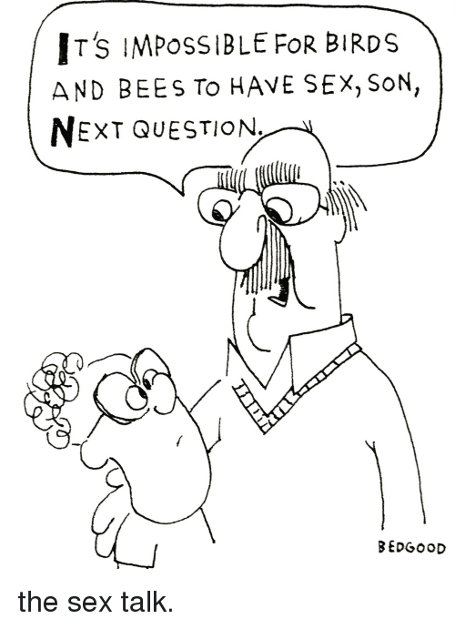

Slide 25
Normal Puberty/Sexual Development
When does puberty start?
Mean onset for girls is 9.5-10 years old (range 8-12, 2nd-6th grade)
Mean onset for boys is 11.5 (range 9-13)
Normal progression of puberty
“Boobs, Pubes, Spurt, Squirt”
Menarche (first period) is 2-2.5 years after breast
development starts
When does the brain mature/develop???
The brain does not fully mature until the mid-to-late 20’s
Teen brains naturally make impulsive, risk-taking decisions
Notes:
Leukorrhea starts about 6-12 mo before menarche
Adolescent bodies are more susceptible to STIs
The same reason we all pay higher insurance premiums for our kids auto insurance! Driving a dangerous vehicle with an immature brain – giving your Ferrari to a 6 year old!

Slide 26
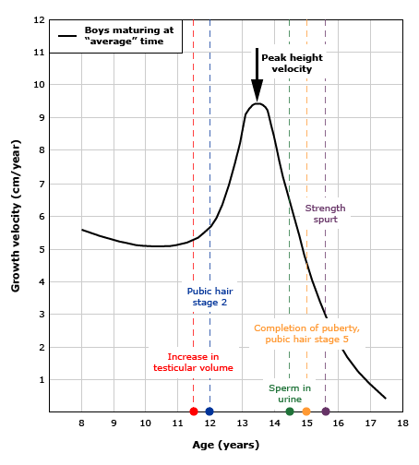
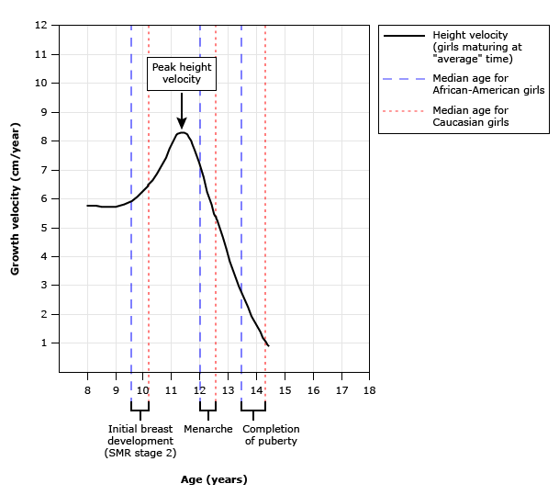
Normal Female Puberty
Normal Male Puberty
From UpToDate.com
Notes:
Average guy starts needing to shave at age 16
BRAIN DEVELOPMENT is WAY off the chart to the RIGHT!!!

Slide 27
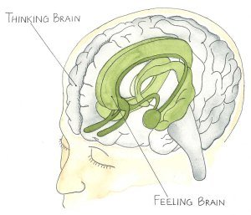
Your Two Brains
“The Feeling Brain” (The Limbic System)
Where emotions come from
Automatic and responds to stimuli extremely fast
3 main objectives:
To survive physically
To avoid pain
To pursue pleasure
Weakness – it does not know right from wrong!
“The Thinking Brain” (The Pre-Frontal Cortex)
Slower acting
Takes time to develop
Where we learn to:
Plan
Solve Problems
Weigh consequences, learn right from wrong
Use self-control (!!!)
Develop “brakes” for our basic emotions and drives (take charge of “the feeling brain”)
Not fully developed until mid-to-late 20’s!
Notes:
Feeling Brain:
Makes us want we believe we need and rewards us with feelings of pleasure for repeating those actions (rewards system, Dopamine – adolescent brain is 2-4x more sensitive to this)
Weakness – it does not know right from wrong!
Addiction corrupts the reward system so that it rewards addictive behaviors that are not helpful for survival.
Thinking Brain:
Can be weakened/shrink as an addiction transfers strength and control to the limbic system.
Can be strengthened by focused meditation, exercising self-discipline, acting on plans to achieve goals.
Does not fully mature until age 25 or later!

Slide 28
Normal Parent-Child Relationship Stages (aka “early brain development stages”)
“Copycat” Phase – ages 2 to 5 = consequential copying
“Counseling” Phase – ages 6 to 11 = considering their beliefs
“Coaching” Phase – ages 12 to adult = adjusting their beliefs
Notes:
Gender identity confusion is COMMON in the copycat phase due to a lot of factors – example of Esther (right below 2 older boys) – “a girl who likes boy things”
Charlize Theron’s son – she labeled him as “transgender” at age 3 – “Who they want to be is not for me to decide.”

Slide 29
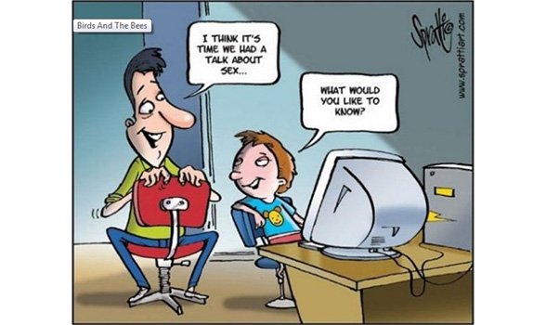

Slide 30
Current Methods of Sex Education
Sexual Risk Reduction (Comprehensive Sex Education)
Sexual Risk Avoidance (Abstinence-based)
Parents forming a child’s worldview…
Notes:
Tell our story of involvement in sex education towards middle school age kids
Personal example of in-office discussions at 11-12 = anecdotally no significant impact on families that had not brought the subject up yet – BELIEF SYSTEM ALREADY ESTABLISHED
Personal story of in-office discussions about sex with patient/parents – usually starting at ages 10-12 – many parents “thanking” me for starting the discussion then, patients continued to become sexually active in teen years despite my repeated efforts
Just like obedience training for animals will be best when incorporating parents as the main trainers, sex education will always best be done when parents are the main “trainers”
We’ll spend the rest of our talk under the assumption that a person’s worldview is the single greatest motivator and effector of behavior long-term.
The absence of discussion on this topic at home creates an automatic conclusion by a child that their parents cannot help them in this area – and they’ll look for their answers elsewhere!

Slide 31
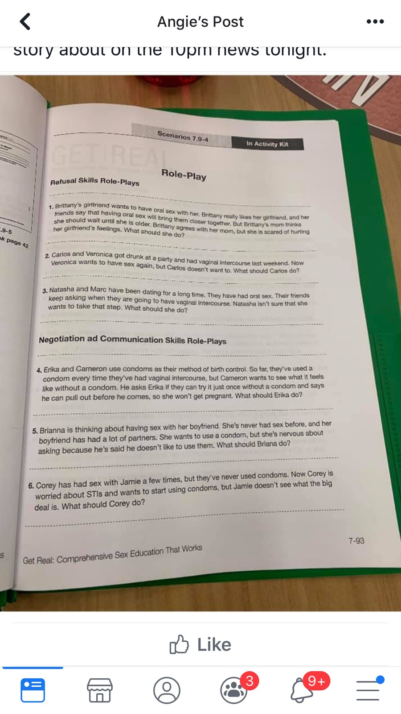
“Role-Play” Activity from Austin ISD’s Comprehensive Sex Education program for 7th grade (2019)
Notes:
Read one of the examples of Austin ISD’s curriculum – speaks for itself.

Slide 32
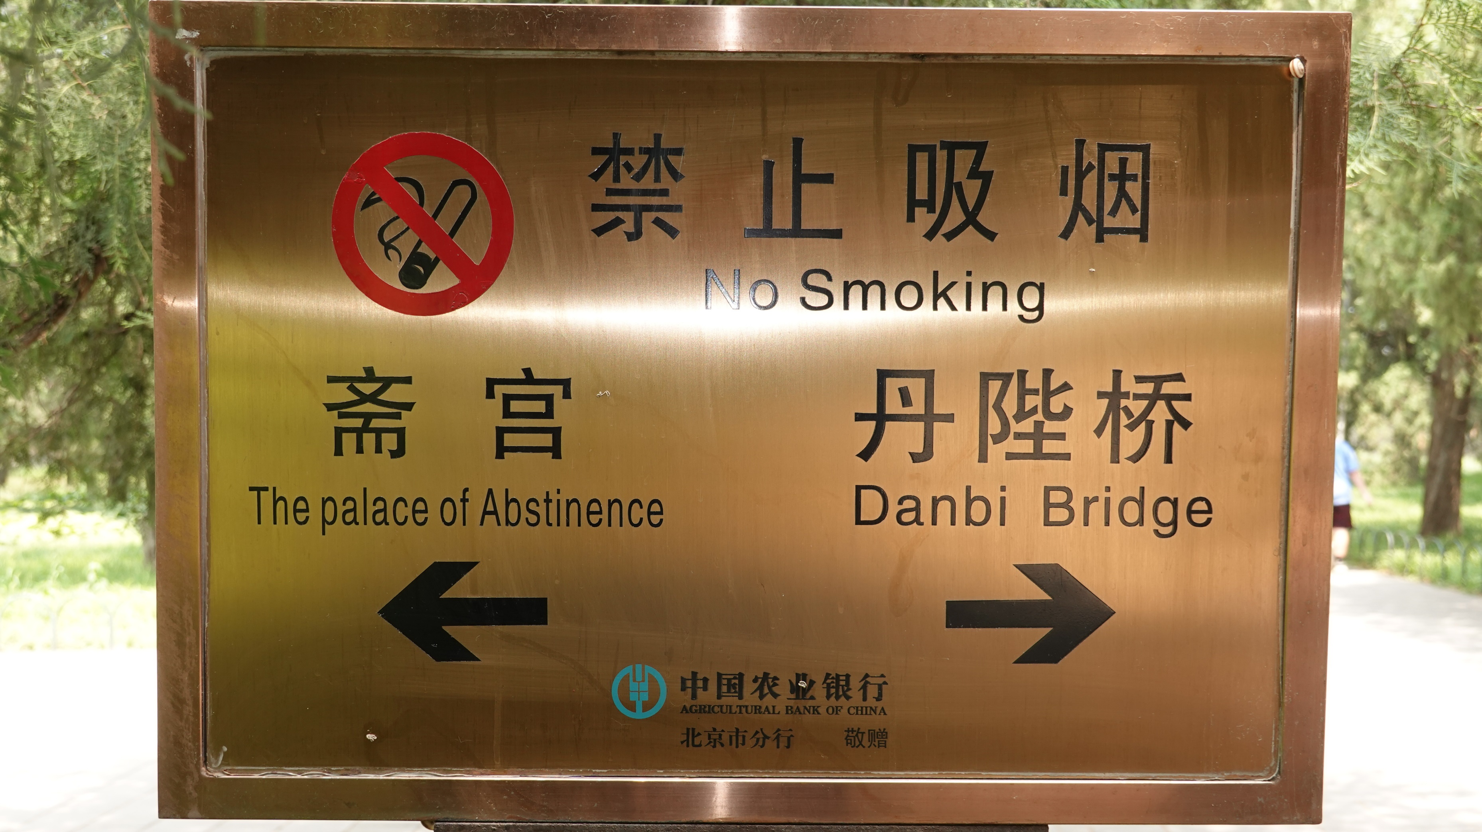
Notes:
The term “abstinence” has fallen out of favor in current sex education circles due to negative connotations/portrayals in the 1990s.
Historically (as evidenced by this picture) it has a good connotation – espousing self-control (a fruit of the spirit!).
But over-emphasizing one aspect of sexuality can have negative consequences (purity movement vs. impurity) – emphasize the “why” and the heart/spirit of the matter.
- Example of Joshua Harris – both his book and life/renouncement of his faith

Slide 33
A Vision for Our Kids
“Where there is no vision, the people are unrestrained.” – Proverbs 29:18
Truth
Grace
“And the Word became flesh and dwelt among us, and we have seen his glory, glory as of the only Son from the Father, full of grace and truth.” – John 1:14 (ESV)
Notes:
(To Audience): Have you ever cast a vision for your kids? What would that look like in just a few words??? (Pause)
“unrestrained” - Hebrew is “Para” (paw-rah) = to let loose, let alone, neglect, avoid
“And the Word became flesh and dwelt among us, and we have seen his glory, glory as of the only Son from the Father, full of grace and truth…For the law was given through Moses; grace and truth came through Jesus Christ.” – John 1:14, 17 (ESV)
Truth – knowing God’s truth, and applying it to their lives. Hopefully this would lead to holiness in heart, mind, and behavior
Grace – receiving grace from God through Christ’s substituionary death on the cross for their, allows them to given and extend grace to others’ in their lives
This vision should apply to ALL aspects of their lives – especially including their sexuality
Usually will require our kids to be counter-cultural
We are all either being shaped by God and His word, or the world and its culture! They have two very different outcomes.
For an effective, gospel-oriented life, you can’t have one without the other.

Slide 34
“What should we teach our kids?”
Chastity in Singleness
Holy Sexuality
Faithfulness in Marriage
Notes:
What should we teach our kids???
2 paths (not choices):
Chastity in singleness = more than abstention from extra-marital sex, but purity and holiness
Sexual abstinence until marriage is the ideal and God’s design
Faithfulness in marriage = more than maintaining chastity and illicit sex, but a covenantal commitment
Holy Sexuality is God’s good standard for everyone!
Godly Marriage and Godly Singleness are two sides of the same coin…
(The Purity Narrative can be both encouraging and harmful at the same time)

Slide 35
Notes:
What is your identity? Is it your name, your family, your hobby/sport/talent, your culture, your sexuality, your religion???
IDENTITY is one of the biggest lies that our culture/world is trying to use against us – especially in the area of sexuality.

Slide 36
Sex Discussion Timeline
3 years old: Start intentional conversations
6-7 years old: Child should know what “sex” is
8-10 years old: More comprehensive discussions
the traditional age of 11-12 (5th/6th grades) for “the talk” is too late!!!
Notes:
MOST IMPORTANT SLIDE!!!
When should we start discussing sex and sexual development with our kids???
Their worldview is being formed as early as 2 years old!!!
6-8 yo = Kindergarten to 2nd grade
Not my recommendations alone – James Dobson is another proponent of early parental sex education
8-10 yo – 2nd to 4th grade – age you start or go more in-depth may depend on your family dynamics (bigger family/older kids), discussions with other kids at church/sports
Don’t underestimate MEDIA exposure or ability to navigate the internet
NSFG Survey of 15-19 yo – only 11.7% (girls) and 17.8% (boys) reported hearing about “how to say no to sex” in grades 1-5 – rest were in grades 6-9 mostly (approx. 14-15% per after then)
https://www.cdc.gov/nchs/nsfg/key_statistics/s.htm#sexeducation

Slide 37
Intentionality!
Don’t neglect or ignore the opportunity to do that which God has given you the unique position of greatest influence in your child’s life!
If they aren’t used to discussing these difficult topics with you from a young age, then they won’t want to discuss them when they really get difficult.
Don’t leave it to the church.
Don’t assume “they will just turn out right.”
Schedule it!
If you don’t teach them, then who will they learn from???
Notes:
You wouldn’t leave the most important thing – the Gospel – to “just happen” or “hope it turns out right”, would you?
All of the most important parenting topics/issues will be conveyed through INTENTIONAL means.

Slide 38
“You shall love the Lord your God with all your heart and with all your soul and with all your might. And these words that I command you today shall be on your heart. You shall teach them diligently to your children, and shall talk of them when you sit in your house, and you walk by the way, and when you lie down, and when you rise.” - Deuteronomy 6:5-7
Notes:
Part of the famous “Shema” of the Old Testament.
What words jump out at you?
It starts with loving God first – out of a godly heart then flow GOD’S WORDS – which then you teach DILIGENTLY through normal, daily conversation.
This is a great model for how to teach truth of any kind!
As a Christian, I know that ultimate truth is ALL God’s truth – and so when I convey His truth and His words, there can be greater, eternal consequences….

Slide 39
Parenting Tips
Look for teachable moments
Keep an ongoing conversation…
Create a culture of openness in your home
Normalize the awkwardness!
Don’t shy away from difficult topics
Be positive!
Define sex/pornography – use proper terminology/body parts
Share your own struggles (age-appropriate)
Use resources from others who have been down this road before!
Notes:
Teachable moments – especially around media/movies/TV/news, after school discussions, in the car
Time – plan ahead – after dinner/before bed, weekend retreats
Ongoing – NOT “the talk” or a one time thing - if you’re being intentional and using teachable moments, then the continuous conversation will naturally occur
“You shall love the LORD your God with all your heart and with all your soul and with all your might. And these words that I command you today shall be on your heart. ^{7 g}You shall teach them diligently to your children, and shall talk of them when you sit in your house, and when you walk by the way, and when you lie down, and when you rise. You shall bind them as a sign on your hand, and they shall be as frontlets between your eyes. You shall write them on the doorposts of your house and on your gates.” – Deuteronomy 6:5-9 (ESV)
Its awkward for both of you! – acknowledge the normalcy of those feelings – then push through them!
Sometimes we (I) tend to focus on the negative of sex outside of marriage – but emphasizing the positives of sex in marriage is an even better point.
Openness about your own struggles/mistakes (age-appropriate) will encourage their own openness about feelings/failures/struggles
- Teach your kids how to engage well with culture.
Make sure your kids know that no topic is off-limits
Be direct, tell the truth.
Make sure you and your spouse are on the same page.
Don’t rely on scare tactics.
Emphasize that sex is good and beautiful and that it is God’s idea
Be creatively discerning and keep the conversation going.
Pray!
Teens need to talk! They already know the truths put into their brain the first 12 years. Listen to them! And they often talk themselves to the right answer.
PEER GROUP has huge influence in teen decision making. Talking through situations beforehand can help them make better decisions.
So what would you call all of this “intentionality” and “parenting tips”???

Slide 40
Sexual Discipleship
Notes:
Does this seem like an odd pairing of words?
Does it make you feel uncomfortable?
Discipleship is the most quintessential way to view the relationship of a God-fearing parent and their children.
So taking every aspect of their lives and helping them conform it fully to God’s design – that’s the premise behind sexual discipleship.
Its something that takes time to cultivate and will likely involve some hard lessons and ups/downs and does not have a “finish line” necessarily.
It requires openness and vulnerability in your own journey and mistakes (age-appropriate).
- Before you were married, did anyone tell you about the struggles that you may continue to face? About the blessings that can come?

Slide 41
“Paradigm Shifts”
Sexual discipleship is an opportunity to conform our lives to Christ.
Every sexual issue is ultimately a spiritual issue.
The Gospel is written within our sexuality.
We are all sexually broken.
Jesus came to redeem our broken sexuality.
Truth and love must co-exist.
It all begins with us.
Notes:
“Paradigm Shifts” - these are truths that can’t just stay in your head, but must influence how you live and how you interact with people
The World has been discipling us about sexuality for a long time – we need to actively pursue “sexual discipleship” to reverse that – which is an opportunity for spiritual discipleship too.
What you believe about sex ultimately begins with what you believe about God.
Someone wants to destroy holy sexuality.

Slide 42
Dr. Howard Hendricks
“We should not be ashamed to discuss what God was not ashamed to create.”
Notes:
Covenanteyes.org Porn Stats Packet
Leadership Journal, “The leadership survey on pastors and internet pornography,” Christianity Today, Jan. 1, 2001. http://www. christianitytoday.com/le/2001/winter/12.89.html (accessed June 7, 2018).

Slide 43
Parenting Resources
Notes:
“God’s Design for Sex” Series – an easy way to guide discussions from the early years (3-5, 5-8, 8-11, 11-14)
Good Pictures, Bad Pictures – helps kids understand how addictions occur, and what to do WHEN they see porn (because they will)
Body Books – easy/fun discussions about puberty changes for ages 8-10 – can be done in 5 minutes chapters nightly over a month
FamilyLife – non-denom Christian go-to for great resources, articles, podcasts on this and other family-related subjects
Secret Keeper Girl (True Girl) – one night conferences to forge bonds on Godly womanhood (and Born2BeBrave for guys)
Circle w/ Disney – additional layer of protection/control for technology at home or on-the-go (that’s a whole separate discussion!)

Slide 44
Parenting Resources
Notes:
“Raising A…” – importance of milestones and ceremony to usher in manhood/womanhood
Passport2Identity – finding your identity in Christ/God’s purpose for your life

Slide 45
Spiritual Truths
God’s Design – Genesis 1:27, 31, 2:24-25
Sin – Romans 3:23
Forgiveness – Rom 5:8, 1 Peter 3:18, 1 John 1:9
Temptation – 1 Cor 10:13, Psalm 119:9,11
Self-control – Ephesians 5:22-23, 1 Peter 2:11
Idolatry – Colossians 3:5
Identity in Christ – Gen 1:27, Gal 2:20, Col 3:1-3
Humility, Grace with others – Phil 2:3, Eph 4:29
Goal is heart change (not behavioral modification)
Notes:
“So God created man in his own image, in the image of God he created him; male and female he created them…. And God saw everything that he had made, and behold, it was very good.” – Genesis 1:27, 31 (ESV)
”For all have sinned and fall short of the glory of God” – Romans 3:23 (NKJV)
“But God demonstrates His own love toward us, in that while we were still sinners, Christ died for us.” – Romans 5:8 (NKJV)
“For Christ also suffered once for sins, the just for the unjust, that He might bring us to God, being put to death in the flesh but made alive by the Spirit” – 1 Peter 3:18 (NKJV)
“If we confess our sins, he is faithful and just to forgive us our sins and to cleanse us from all unrighteousness.” – 1 John 1:9 (ESV)
“No temptation has overtaken you except such as is common to man; but God is faithful, who will not allow you to be tempted beyond what you are able, but with the temptation will also make the way of escape, that you may be able to bear it.” – 1 Cor 10:13 (NKJV)
”How can a young man cleanse his way? By taking heed according to Your word…Your word I have hidden in my heart, that I might not sin against You!” – Psalm 119:9,11
A Christian Worldview requires immersion in God’s Word – know it, talk about it, memorize it and hide it in our hearts!!!
“But the fruit of the Spirit is love, joy, peace, patience, kindness, goodness, faithfulness, gentleness, self-control.” – Ephesians 5:22-23 (ESV)
“Beloved, I beg you as sojourners and pilgrims, abstain from fleshly lusts which war against the soul.“ – 1 Peter 2:11 (NKJV)
“Sexual Self-Control” – COUNTER CULTURAL today – must happen by the Spirit.
“abstain” – Greek ‘apecho’ (ap-ekh’-o)– a continual holding back
“Put to death therefore what is earthly in you: sexual immorality, impurity, passion, evil desire, and covetousness, which is idolatry.” – Colossians 3:5
Personal story
“I have been crucified with Christ. It is no longer I who live, but Christ who lives in me. And the life I now live in the flesh I live by faith in the Son of God, who loved me and gave himself for me.” – Galatians 2:20 (ESV)
“If then you have been raised with Christ, seek the things that are above, where Christ is, seated at the right hand of God. Set your minds on things that are above, not on things that are on earth. For you have died, and your life is hidden with Christ in God.” – Colossians 3:1-3 (ESV)
Identity is not WHAT I do or HOW I am, but WHO I am.
Holy Sexuality is a term that helps steer away from the “identity” words of heterosexuality and homosexuality…
“Do nothing from selfish ambition or conceit, but in humility count others more significant than yourselves.” – Philippians 2:3 (ESV)
“Let no corrupting talk come out of your mouths, but only such as is good for building up, as fits the occasion, that it may give grace to those who hear.” – Ephesians 4:29
We are all sexually broken, all of our kids WILL be sexually broken as well, and also their friends and everyone they come into contact with.
We need to show humility and grace when dealing with the hurt/shame/guilt/pain of sexual brokenness in others’ lives.
GRACE (receiving a gift you don’t deserve) is attractive and draws people in to the Gospel – because some people (including our kids) will REJECT spiritual/theological “arguments”, we need to have an aroma of grace about us.

Slide 46
Notes:
Please “stand firm” in your faith! The most important thing when dealing with issues of sexuality.
1 Cor 15:58: “Therefore, my beloved brethren, BE STEADFAST, immovable, always abounding in the work of the Lord, knowing that your labor is not in vain in the Lord.”

Slide 47
Bill Perkins
“If you think you can’t fall into
sexual sin, then you’re
godlier than David,
stronger than Samson, and
wiser than Solomon.”
Notes:
Covenanteyes.org Porn Stats Packet
Leadership Journal, “The leadership survey on pastors and internet pornography,” Christianity Today, Jan. 1, 2001. http://www. christianitytoday.com/le/2001/winter/12.89.html (accessed June 7, 2018).

Slide 48
Take-Home Points
Your child’s worldview is being formed from the age of 2.
Start intentional discussions EARLY – teach the basics by age 6-7.
Your child WILL learn about sex – make sure it is from YOU!
Action Plan:
Buy a book, sign up for a podcast, read up on resources.
Intentionally schedule time to engage your kids in meaningful discussion.
REPEAT above! Keep the conversations going...
Notes:
TAKE THE NEXT STEP!
Don’t just check a box! Engage in discussion that can continue.
Date your kids!!!

Slide 49
Questions???
Leighton – lhcarl@gmail.com
Jenny – snowcarl@gmail.com

